Slide 1
SMART PARKING SYSTEM
PG-30

Slide 2
INDEX
Introduction
Components used
Circuit Diagram
Working
Understanding IoT
About NodeMCU
About Adafruit IO
Conclusion

Slide 3
INTRODUCTION
Introducing our cutting-edge project: A Smart Parking System utilizing the power of the Internet of Things (IoT). In a world where finding a parking space in bustling areas poses a formidable challenge, our innovative solution combines NodeMCU, ultrasonic and infrared sensors, and servo motors to revolutionize parking space management. This advanced IoT device ,equipped with NodeMCU microcontroller and Wi-Fi connectivity, employs ultrasonic or infrared sensors to efficiently detect vehicle presence in individual parking spots. Real-time data transmission to a centralized system or mobile application empowers users to access crucial parking space information, enabling them to make informed decisions about where to park.
To enhance accessibility and global monitoring, we leverage the Adafruit IO platform, enabling the publication of real-time data to the cloud. With our Smart Parking System, users can remotely check parking availability from anywhere in the world, providing a seamless and efficient solution to the perennial parking predicament in urban environments.

Slide 4
HARDWARE COMPONENTS
Node MCU
IR Sensor-5
Servo Motor-2
Breadboard-1
Jumper Wires
DIGITAL PLATFORM
Adafruit IO

Slide 5
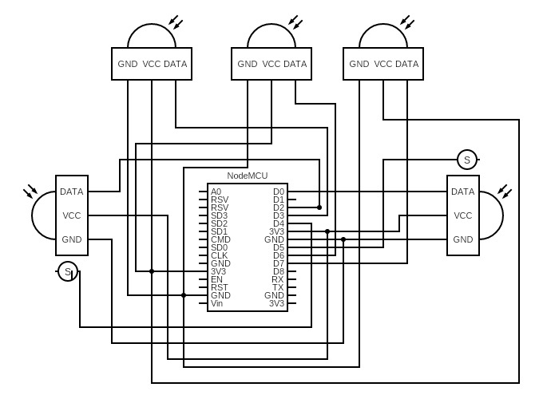
CIRCUIT DIAGRAM

Slide 6
WORKING
Within this IoT-driven Smart Parking System, we deploy five IR Sensors and two servo motors, seamlessly interfaced with the NodeMCU. Functioning as the central orchestrator, the NodeMCU directs the entire operation, transmitting pertinent parking details and duration information to Adafruit IO for global accessibility. The entry and exit gates integrate two IR sensors, automatically identifying approaching vehicles and prompting the servo motors to initiate gate movements.
Acting as the entry and exit gates, the servo motors undergo automated rotations spanning 45° to 140° upon the detection of a vehicle by the IR sensors. Following a brief pause, they revert to their initial positions. Simultaneously, an additional trio of IR sensors assess the occupancy status of parking slots, relaying this information to the NodeMCU. Enhancing operational control, the Adafruit IO dashboard incorporates manual buttons for independently managing both entry and exit gates.

Slide 7
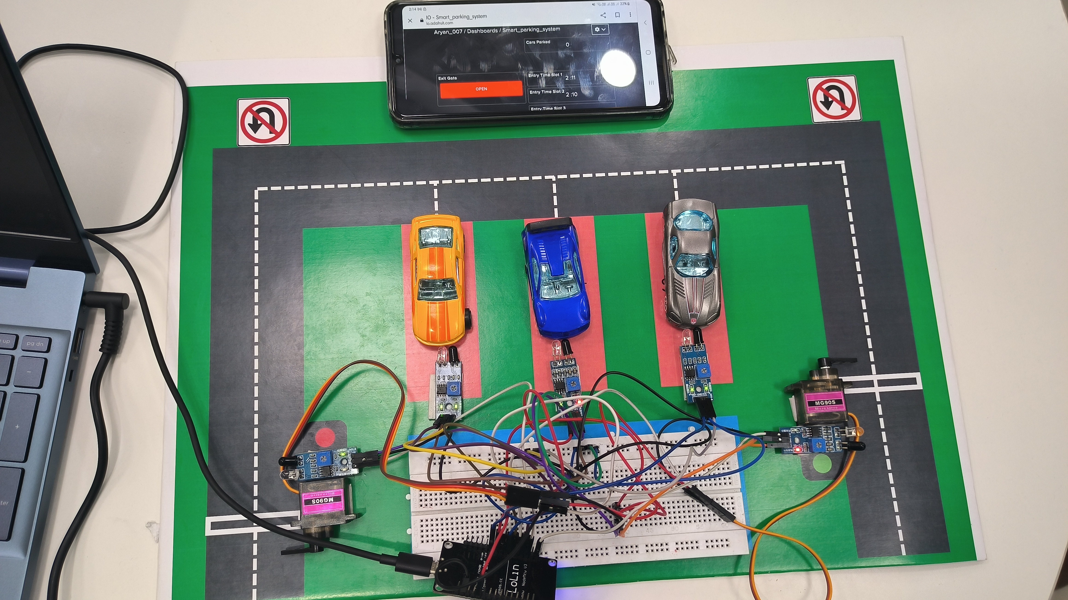

Slide 8
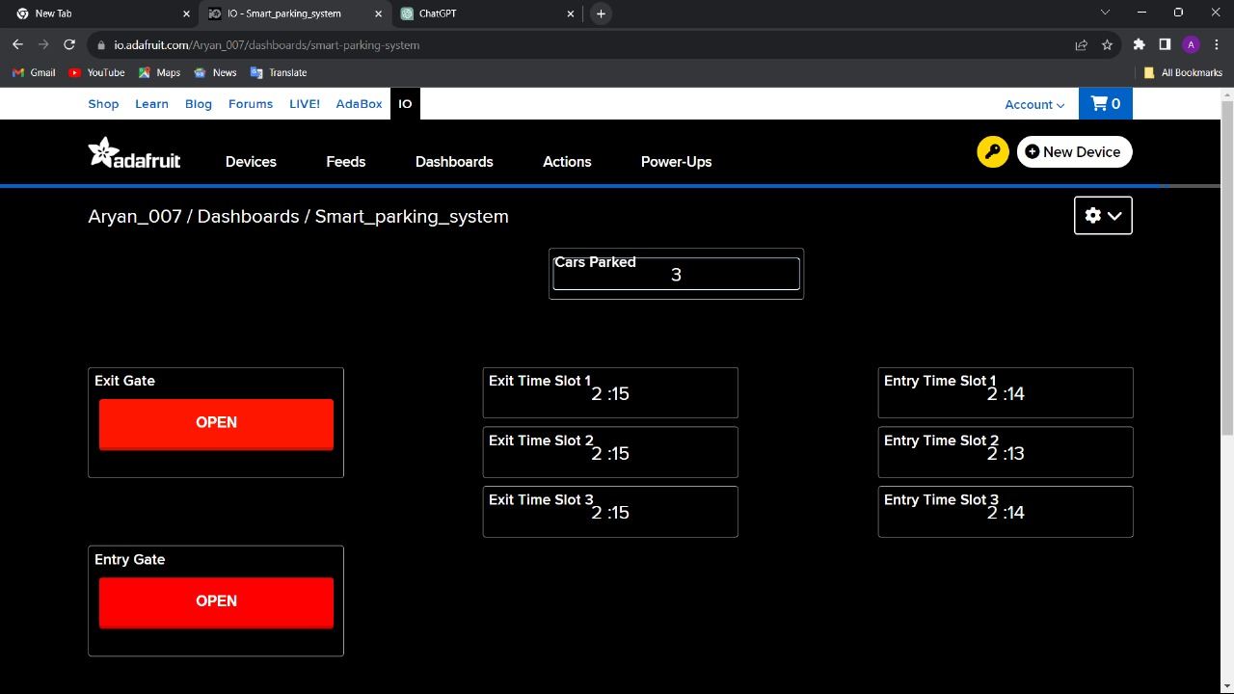

Slide 9
UNDERSTANDING IoT
The Internet of Things (IoT) refers to a network of interconnected devices that communicate and share data over the internet. These devices, equipped with sensors and actuators, collect and transmit information, enabling them to interact with the environment and respond to specific conditions. IoT applications are diverse and are found in various sectors, including smart cities, healthcare, agriculture, and transportation.
IoT Implementation in the Smart Parking System:
In the Smart Parking System project, IoT is seamlessly integrated to enhance parking management and user experience. The key IoT components and their roles in the project are as follows:
IR Sensors:
Five Infrared (IR) sensors are strategically placed to detect the presence

Slide 10
of vehicles. These sensors act as data collection points, providing information about parking space occupancy. The data collected is processed by the NodeMCU for further transmission
Servo Motors:
Two servo motors are utilized for the automated entry and exit gates. Controlled by the NodeMCU based on inputs from IR sensors, these motors showcase the actuation aspect of IoT, responding to real-time data to automate gate movements.
Real-Time Data Transmission:
The NodeMCU facilitates real-time data transmission to the Adafruit IO platform. This represents the core IoT feature, where the collected data is sent to a centralized platform for storage, analysis, and accessibility.
NodeMCU Microcontroller , Adafruit IO are elaborated in the next slides

Slide 11
NODEMCU
What is NodeMCU?
NodeMCU is an open-source firmware and development kit that facilitates the building of IoT (Internet of Things) applications. It is based on the ESP8266 WiFi module and uses the Lua scripting language. NodeMCU provides a user-friendly environment for developing and prototyping IoT projects, offering a range of functionalities in a compact and easily programmable form.
What is NodeMCU ESP8266
The NodeMCU ESP8266 specifically refers to the hardware platform incorporating the ESP8266 WiFi module. The ESP8266 is a highly integrated system-on-chip (SoC) that combines a microcontroller with WiFi capabilities. It is known for its cost-effectiveness, low power consumption, and reliable performance, making it a popular choice for IoT applications.

Slide 12
The NodeMCU serves as the IoT-enabled microcontroller at the heart of the project. With its built-in Wi-Fi capabilities, NodeMCU connects to the internet, facilitating real-time data transmission and communication with other IoT elements.
The NodeMCU ESP8266 serves as the central component that empowers the integration of IoT functionalities. Leveraging its WiFi connectivity, NodeMCU facilitates real-time data transmission from Infrared (IR) sensors strategically placed in the parking system. It processes information about vehicle presence, enabling intelligent decision-making for automated gate operations and parking slot status. NodeMCU acts as the communication bridge between the physical components of the parking system and the cloud platform, Adafruit IO, allowing for efficient data storage and remote monitoring. This microcontroller's role extends to ensuring seamless connectivity, efficient system operations, and the realization of a connected and intelligent parking solution within the IoT framework.

Slide 13
ADAFRUIT IO
Adafruit IO acts as the central cloud platform for real-time data management from the NodeMCU microcontroller. It efficiently stores information about parking space availability and gate operations, providing remote access to dashboards for quick insights. Adafruit IO's seamless communication enhances IoT capabilities by streamlining data exchange through protocols like MQTT or HTTP.
Additionally, Adafruit IO ensures data security through robust features like authentication and access controls. Its scalability supports the system's adaptability, allowing for future expansions and increased data volume. In summary, Adafruit IO plays a key role in optimizing efficiency, securing data, and contributing to the adaptability of our Smart Parking System within the IoT landscape.

Slide 14
CONCLUSION
In summary, our Smart Parking System, powered by IoT technology, revolutionizes urban parking management. Through the integration of NodeMCU, five IR sensors, and two servo motors, the system automates parking, providing real-time data on availability and usage via Adafruit IO. This not only streamlines the parking process but also contributes to environmental sustainability by minimizing fuel consumption and emissions.
Beyond its efficiency in optimizing parking operations and mitigating traffic congestion, our Smart Parking System addresses the broader concerns of fuel consumption and emissions. By minimizing the time spent searching for parking spots, our solution contributes to environmental sustainability The automated entry and exit gates, responsive to IR sensors, enhance operational efficiency. Leveraging the Adafruit IO platform for cloud-based data publication enables remote monitoring, empowering users to manage the system globally. In essence, our Smart Parking System represents a practical IoT-driven solution that addresses urban mobility challenges, offering a glimpse into a smarter, more connected future.

